Slide 1

Chapter 8 Security
A note on the use of these PowerPoint slides:
We’re making these slides freely available to all (faculty, students, readers). They’re in PowerPoint form so you see the animations; and can add, modify, and delete slides (including this one) and slide content to suit your needs. They obviously represent a lot of work on our part. In return for use, we only ask the following:
If you use these slides (e.g., in a class) that you mention their source (after all, we’d like people to use our book!)
If you post any slides on a www site, that you note that they are adapted from (or perhaps identical to) our slides, and note our copyright of this material.
For a revision history, see the slide note for this page.
Thanks and enjoy! JFK/KWR
All material copyright 1996-2020
J.F Kurose and K.W. Ross, All Rights Reserved
Computer Networking: A Top-Down Approach 8th edition Jim Kurose, Keith Ross Pearson, 2020
Notes:
Version History
8.0 (May 2020)
All slides reformatted for 16:9 aspect ratio
All slides updated to 8th edition material
Use of Calibri font, rather that Gill Sans MT
Add LOTS more animation throughout
lighter header font
wireless security completely redone (updated WiFi and added 4G/5G)
SSL material replaces by TLS 1.3 (up-to-date)

Slide 2
Security: overview
Chapter goals:
understand principles of network security:
cryptography and its many uses beyond “confidentiality”
authentication
message integrity
security in practice:
firewalls and intrusion detection systems
security in application, transport, network, link layers

Slide 3

Chapter 8 outline
What is network security?
Principles of cryptography
Message integrity, authentication
Securing e-mail
Securing TCP connections: TLS
Network layer security: IPsec
Security in wireless and mobile networks
Operational security: firewalls and IDS

Slide 4

What is network security?
CIA
confidentiality: only sender, intended receiver should “understand” message contents
sender encrypts message
receiver decrypts message
authentication: sender, receiver want to confirm identity of each other
message integrity: sender, receiver want to ensure message not altered (in transit, or afterwards) without detection
access and availability: services must be accessible and available to users

Slide 5



Friends and enemies: Alice, Bob, Trudy
well-known in network security world
Bob, Alice (lovers!) want to communicate “securely”
Trudy (intruder) may intercept, delete, add messages
Alice
channel
data, control messages
Bob
secure
sender
secure
receiver
data
data
Trudy

Slide 6
Friends and enemies: Alice, Bob, Trudy
Who might Bob and Alice be?
… well, real-life Bobs and Alices!
Web browser/server for electronic transactions (e.g., on-line purchases)
on-line banking client/server
DNS servers
BGP routers exchanging routing table updates
other examples?

Slide 7
There are bad guys (and girls) out there!
Q: What can a “bad guy” do?
A: A lot! (recall section 1.6)
eavesdrop: intercept messages
actively insert messages into connection
impersonation: can fake (spoof) source address in packet (or any field in packet)
hijacking: “take over” ongoing connection by removing sender or receiver, inserting himself in place
denial of service: prevent service from being used by others (e.g., by overloading resources)

Slide 8
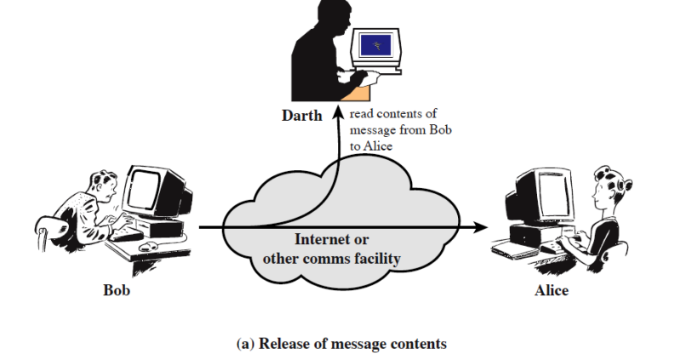
Passive Attack (1) Eavesdrop

Slide 9
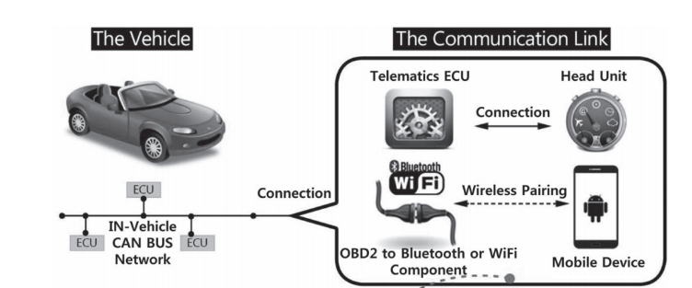
Passive Attack (1) Eavesdrop
No longer popular, as most data going through the Internet are encrypted!
Some IoT system may still suffer

Slide 10
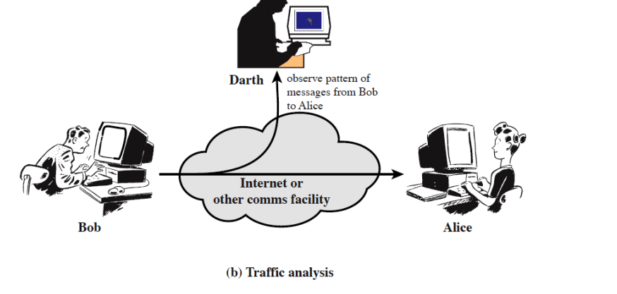
Passive Attack (2) Traffic Analysis
Even for encrypted data!

Slide 11
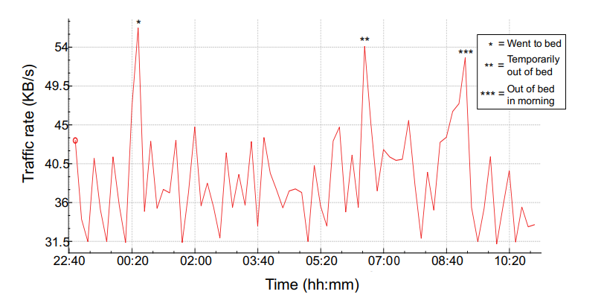
Traffic Analysis Example
“Spying on the smart home: Privacy attacks and defenses on encrypted IoT traffic”
Notes:
Research from Princeton, published in year 2017,

Slide 12
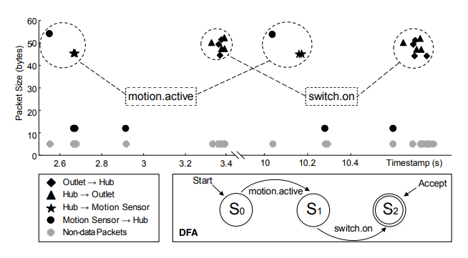
Traffic Analysis Example
“HoMonit: Monitoring Smart Home Apps from Encrypted Traffic”, CCS’18
Notes:
Brighten My Path is a SmartApp for automatically turning on the outlet after a motion has been detected by the motion sensor
motion.active corresponds to packet sequence (54 ↑) and switch.on corresponds to packet sequence (50 ↓, 47 ↓, 47 ↓, 52 ↓),

Slide 13
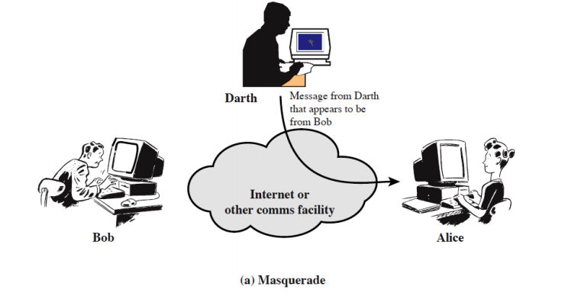
Active attack (1) - spoofing

Slide 14
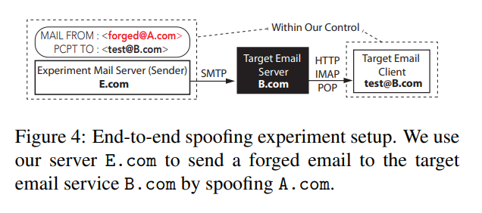
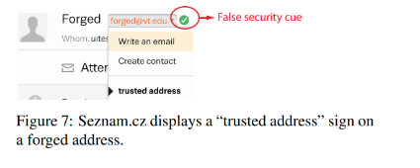
Email Spoofing Attack
End-to-End Measurements of Email Spoofing Attacks, UsenixSecurity’18
Conclusion: We demonstrate that most email providers allow forged emails to get to user inbox, while lacking the necessary warning mechanism to notify users (particularly on mobile apps).

Slide 15
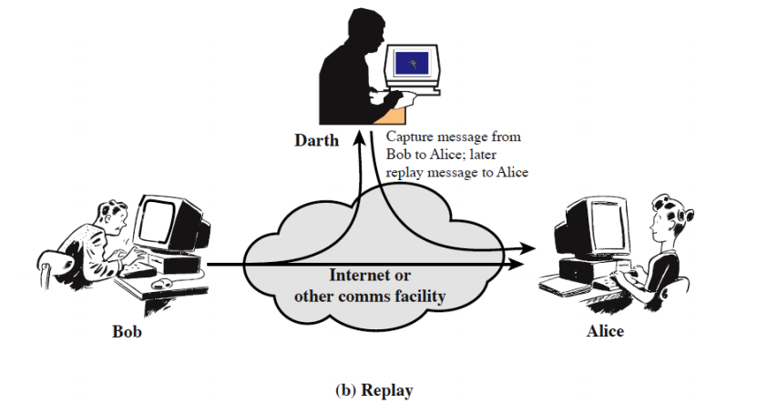
Active (2) - replay

Slide 16
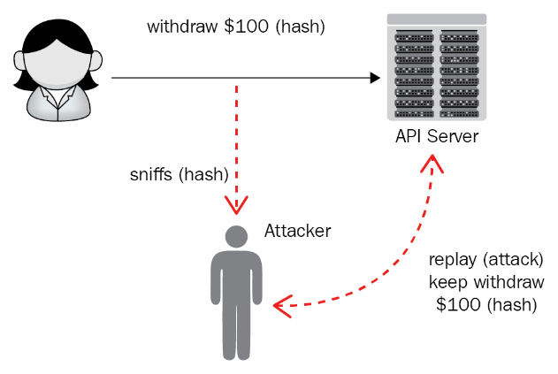
Replay Attacks
Usually integrated with Sniffing (eavesdropping )
Notes:
The legitimate user sends a valid request, but the attacker spoofs it and resends/replays it to the APIs.
As RESTful APIs are stateless, the attacker can keep withdraw caches.
How to prevent replay attacks？Add some randomness for each communication. For example, add a timestamp for each withdraw, or use a password for each transaction that’s only used once and discarded.

Slide 17
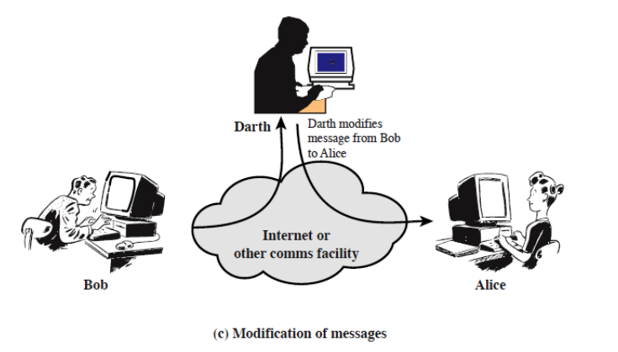
Active (3) – intercept & modify
Man in the middle attack!

Slide 18
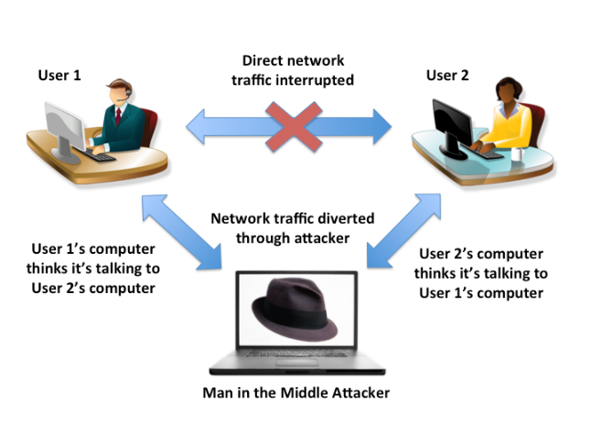
Man in the Middle Attack
Attacker pretends to be the sender/receiver

Slide 19

Is this right?
What is the difference between MITM & Eavesdropping?

Slide 20
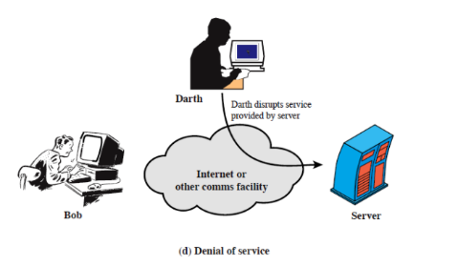
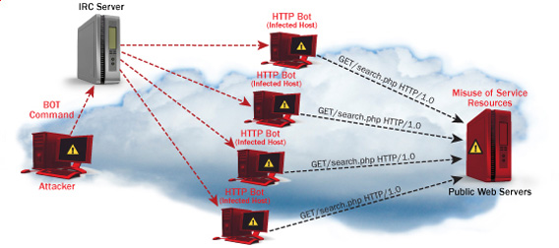
Active (4) - DoS
Notes:
Amazon Web Services (AWS) reports that in February 2020, they defended against a 2.3 -terabit-per-second (Tbps) distributed denial of service (DDoS) attack!
In Q1 2020, a known UDP reflection vector, CLDAP reflection, was observed with a previously unseen volume of 2.3 Tbps. This is approximately 44% larger than any network volumetric event previously detected on AWS. CLDAP reflection attacks of this magnitude caused 3 days of elevated threat during a single week in February 2020 before subsiding. Despite this observation, smaller network volumetric events are far more common. The 99th percentile event in Q1 2020 was 43 Gbps.”

Slide 21
Chapter 8 outline
What is network security?
Principles of cryptography
Message integrity, authentication
Securing e-mail
Securing TCP connections: TLS
Network layer security: IPsec
Security in wireless and mobile networks
Operational security: firewalls and IDS

Slide 22
The language of cryptography
Alice’s
encryption
key
Bob’s
decryption
key
K
A
K
B
plaintext
encryption
algorithm
ciphertext
decryption
algorithm
plaintext
m: plaintext message
K_{A}(m): ciphertext, encrypted with key K_{A}
m = K_{B}(K_{A}(m))

Slide 23
Breaking an encryption scheme
cipher-text only attack: Trudy has ciphertext she can analyze
two approaches:
brute force: search through all keys
statistical analysis
known-plaintext attack: Trudy has plaintext corresponding to ciphertext
e.g., in monoalphabetic cipher, Trudy determines pairings for a,l,i,c,e,b,o,
chosen-plaintext attack: Trudy can get ciphertext for chosen plaintext

Slide 24
Symmetric key cryptography
K
K
S
S
plaintext
encryption
algorithm
ciphertext
decryption
algorithm
plaintext
K (m)
S
symmetric key crypto: Bob and Alice share same (symmetric) key: K
e.g., key is knowing substitution pattern in mono alphabetic substitution cipher
Q: how do Bob and Alice agree on key value?

Slide 25
Simple encryption scheme
substitution cipher: substituting one thing for another
monoalphabetic cipher: substitute one letter for another
plaintext: abcdefghijklmnopqrstuvwxyz
ciphertext: mnbvcxzasdfghjklpoiuytrewq
e.g.:
Plaintext: bob. i love you. alice
ciphertext: nkn. s gktc wky. mgsbc
Encryption key: mapping from set of 26 letters
to set of 26 letters

Slide 26
A more sophisticated encryption approach
n substitution ciphers, M₁,M₂,…,M_{n}
cycling pattern:
e.g., n=4: M₁,M₃,M₄,M₃,M₂; M₁,M₃,M₄,M₃,M₂; ..
for each new plaintext symbol, use subsequent substitution pattern in cyclic pattern
dog: d from M₁, o from M₃, g from M₄
Encryption key: n substitution ciphers, and cyclic pattern
key need not be just n-bit pattern

Slide 27
Symmetric key crypto: DES
DES: Data Encryption Standard
US encryption standard [NIST 1993]
56-bit symmetric key, 64-bit plaintext input
block cipher with cipher block chaining
how secure is DES?
DES Challenge: 56-bit-key-encrypted phrase decrypted (brute force) in less than a day
no known good analytic attack
making DES more secure:
3DES: encrypt 3 times with 3 different keys

Slide 28
AES: Advanced Encryption Standard
symmetric-key NIST standard, replaced DES (Nov 2001)
processes data in 128 bit blocks
128, 192, or 256 bit keys
brute force decryption (try each key) taking 1 sec on DES, takes 149 trillion years for AES

Slide 29

Public Key Cryptography
symmetric key crypto:
requires sender, receiver know shared secret key
Q: how to agree on key in first place (particularly if never “met”)?
public key crypto
radically different approach [Diffie-Hellman76, RSA78]
sender, receiver do not share secret key
public encryption key known to all
private decryption key known only to receiver

Slide 30
Public Key Cryptography
+
Bob’s public key
K
B
-
Bob’s private key
K
B
plaintext
message, m
encryption
algorithm
ciphertext
decryption
algorithm
plaintext
+
-
+
K (m)
m = K (K (m))
B
B
B
Wow - public key cryptography revolutionized 2000-year-old (previously only symmetric key) cryptography!
similar ideas emerged at roughly same time, independently in US and UK (classified)

Slide 31
Public key encryption algorithms
requirements:
+
.
-
.
1
need K ( ) and K ( ) such that
B
B
-
+
K (K (m)) = m
B
B
+
2
given public key K , it should be impossible to compute private key K
B
-
B
RSA: Rivest, Shamir, Adelson algorithm

Slide 32
Prerequisite: modular arithmetic
x mod n = remainder of x when divide by n
facts:
[(a mod n) + (b mod n)] mod n = (a+b) mod n
[(a mod n) - (b mod n)] mod n = (a-b) mod n
[(a mod n) * (b mod n)] mod n = (a*b) mod n
thus
(a mod n)^{d} mod n = a^{d} mod n
example: x=14, n=10, d=2: (x mod n)^{d} mod n = 4² mod 10 = 6 x^{d} = 14² = 196 x^{d} mod 10 = 6

Slide 33
RSA: getting ready
message: just a bit pattern
bit pattern can be uniquely represented by an integer number
thus, encrypting a message is equivalent to encrypting a number
example:
m= 10010001. This message is uniquely represented by the decimal number 145.
to encrypt m, we encrypt the corresponding number, which gives a new number (the ciphertext).

Slide 34
RSA: Creating public/private key pair
1. choose two large prime numbers p, q. (e.g., 1024 bits each)
2. compute n = pq, z = (p-1)(q-1)
3. choose e (with e<n) that has no common factors with z (e, z are “relatively prime”).
4. choose d such that ed-1 is exactly divisible by z. (in other words: ed mod z = 1 ).
5. public key is (n,e). private key is (n,d).
+
-
K
K
B
B

Slide 35
RSA: encryption, decryption
0. given (n,e) and (n,d) as computed above
1. to encrypt message m (<n), compute
e
c = m mod n
2. to decrypt received bit pattern, c, compute
d
m = c mod n
magic happens!
e
d
m = (m mod n)
mod n
c

Slide 36
RSA example:
Bob chooses p=5, q=7. Then n=35, z=24.
e=5 (so e, z relatively prime).
d=29 (so ed-1 exactly divisible by z).
encrypting 8-bit messages.
m
e
e
bit pattern
m
c = m mod n
encrypt:
0000l000
12
24832
17
d
d
c
c
m = c mod n
decrypt:
17
481968572106750915091411825223071697
12

Slide 37
Why does RSA work?
must show that c^{d} mod n = m, where c = m^{e} mod n
fact: for any x and y: x^{y} mod n = x^{(y mod z)} mod n
where n= pq and z = (p-1)(q-1)
thus, c^{d} mod n = (m^{e} mod n)^{d} mod n
= m^{ed} mod n
= m^{(ed mod z)} mod n
= m¹ mod n
= m

Slide 38
RSA: another important property
The following property will be very useful later:
-
+
+
-
K (K (m)) = m
=
K (K (m))
B
B
B
B
use public key first, followed by private key
use private key first, followed by public key
result is the same!

Slide 39
Why
-
+
+
-
K (K (m)) = m
=
K (K (m))
?
B
B
B
B
follows directly from modular arithmetic:
(m^{e} mod n)^{d} mod n = m^{ed} mod n
= m^{de} mod n
= (m^{d} mod n)^{e} mod n

Slide 40
Why is RSA secure?
suppose you know Bob’s public key (n,e). How hard is it to determine d?
essentially need to find factors of n without knowing the two factors p and q
fact: factoring a big number is hard

Slide 41
RSA in practice: session keys
exponentiation in RSA is computationally intensive
DES is at least 100 times faster than RSA
use public key crypto to establish secure connection, then establish second key – symmetric session key – for encrypting data
session key, K_{S}
Bob and Alice use RSA to exchange a symmetric session key K_{S}
once both have K_{S}, they use symmetric key cryptography

Slide 42
Chapter 8 outline
What is network security?
Principles of cryptography
Authentication, message integrity
Securing e-mail
Securing TCP connections: TLS
Network layer security: IPsec
Security in wireless and mobile networks
Operational security: firewalls and IDS

Slide 43
Authentication
Goal: Bob wants Alice to “prove” her identity to him
Protocol ap1.0: Alice says “I am Alice”
“I am Alice”
failure scenario??

Slide 44
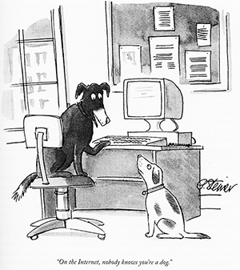
Authentication
Goal: Bob wants Alice to “prove” her identity to him
Protocol ap1.0: Alice says “I am Alice”
in a network, Bob can not “see” Alice, so Trudy simply declares herself to be Alice
“I am Alice”

Slide 45
Authentication: another try
Goal: Bob wants Alice to “prove” her identity to him
Protocol ap2.0: Alice says “I am Alice” in an IP packet containing her source IP address
Alice’s
IP address
“I am Alice”
failure scenario??

Slide 46
Authentication: another try
Goal: Bob wants Alice to “prove” her identity to him
Protocol ap2.0: Alice says “I am Alice” in an IP packet containing her source IP address
Trudy can create
a packet “spoofing”
Alice’s address
Alice’s
IP address
“I am Alice”

Slide 47
Authentication: a third try
Goal: Bob wants Alice to “prove” her identity to him
Protocol ap3.0: Alice says “I am Alice” Alice says “I am Alice” and sends her secret password to “prove” it.
Alice’s
IP addr
Alice’s
password
“I am Alice”
failure scenario??
Alice’s
IP addr
OK

Slide 48
Authentication: a third try
Goal: Bob wants Alice to “prove” her identity to him
Protocol ap3.0: Alice says “I am Alice” Alice says “I am Alice” and sends her secret password to “prove” it.
playback attack: Trudy records Alice’s packet
and later
plays it back to Bob
Alice’s
IP addr
Alice’s
password
“I am Alice”
Alice’s
IP addr
Alice’s
password
“I am Alice”
Alice’s
IP addr
OK

Slide 49
Authentication: a modified third try
Goal: Bob wants Alice to “prove” her identity to him
Protocol ap3.0: Alice says “I am Alice” Alice says “I am Alice” and sends her encrypted secret password to “prove” it.
Alice’s
IP addr
encrypted
password
“I am Alice”
failure scenario??
Alice’s
IP addr
OK

Slide 50
Authentication: a modified third try
Goal: Bob wants Alice to “prove” her identity to him
Protocol ap3.0: Alice says “I am Alice” Alice says “I am Alice” and sends her encrypted secret password to “prove” it.
Alice’s
IP addr
encrypted
password
“I am Alice”
playback attack still works: Trudy records Alice’s packet
and later plays it back to Bob
Alice’s
IP addr
encrypted
password
“I am Alice”
Alice’s
IP addr
OK

Slide 51
Authentication: a fourth try
Goal: avoid playback attack
nonce: number (R) used only once-in-a-lifetime
protocol ap4.0: to prove Alice “live”, Bob sends Alice nonce, R
Alice must return R, encrypted with shared secret key
“I am Alice”
R
K (R)
Bob know Alice is live, and only Alice knows key to encrypt nonce, so it must be Alice!
A-B
Failures, drawbacks?

Slide 52
Authentication: ap5.0
ap4.0 requires shared symmetric key - can we authenticate using public key techniques?
ap5.0: use nonce, public key cryptography
“I am Alice”
R
Bob computes
+
-
-
K
(K (R)) = R
K (R)
A
A
A
and knows only Alice could have the private key, that encrypted R such that
Send me your public key
+
K (R)
+
-
A
K
A
(K (R)) = R
A

Slide 53
Authentication: ap5.0 – there’s still a flaw!
man (or woman) in the middle attack: Trudy poses as Alice (to Bob) and as Bob (to Alice)
I am Alice
I am Alice
?
R
-
K (R)
T
R
Where are mistakes made here?
Send me your public key
-
+
K (R)
K
Bob computes
A
T
+
-
Send me your public key
K
(K (R)) = R,
+
T
T
K
authenticating
Trudy as Alice
A
Trudy recovers m:
+
+
-
+
K (m)
Trudy recovers Bob’s m:
m = K (K (m))
Bob sends a personal message, m to Alice
-
+
K (m)
T
T
m = K (K (m))
A
T
A
A
sends m to Alice encrypted with Alice’s public key
and she and Bob meet a week later in person and discuss m, not knowing Trudy knows m

Slide 54
Chapter 8 outline
What is network security?
Principles of cryptography
Authentication, message integrity
Securing e-mail
Securing TCP connections: TLS
Network layer security: IPsec
Security in wireless and mobile networks
Operational security: firewalls and IDS

Slide 55
Review
Security service: confidentiality, integrity, accessibility (CIA)
System model:
Secure transmission over insecure channels
Bob, Alice (sender, receiver), and Trudy (malicious third party)
Attacks:
Passive: eavesdropping
Active: spoofing, reply, man-in-the-middle, dos
Encryption
Symmetric: both sides share the same key, fast, need to transmit key
Asymmetric: public/private, slow, only owner knows private key.

Slide 56
Q:
If we only consider encryption using public keys, what security service does it provide?
Alice wants to send message m to bob, sends Kb+(m)

Slide 57
Q:
If we only consider encryption using public keys, what security service does it provide?
A: confidentiality, only bob can decrypt m
But:
You cannot guarantee that the message was not faked by Trudy (integrity)
How does Alice know it is indeed Bob who claims to be Bob?

Slide 58
Authentication: ap5.0
Recall the problem: Trudy poses as Alice (to Bob) and as Bob (to Alice)
I am Alice
I am Alice
?
R
-
K (R)
T
R
Where are mistakes made here?
Send me your public key
-
+
K (R)
K
Bob computes
A
T
+
-
Send me your public key
K
(K (R)) = R,
+
T
T
K
authenticating
Trudy as Alice
A
Trudy recovers m:
+
+
-
+
K (m)
Trudy recovers Bob’s m:
m = K (K (m))
Bob sends a personal message, m to Alice
-
+
K (m)
T
T
m = K (K (m))
A
T
A
A
sends m to Alice encrypted with Alice’s public key
and she and Bob meet a week later in person and discuss m, not knowing Trudy knows m

Slide 59

Digital signatures
cryptographic technique analogous to hand-written signatures:
sender (Bob) digitally signs document: he is document owner/creator.
verifiable, nonforgeable: recipient (Alice) can prove to someone that Bob, and no one else (including Alice), must have signed document
simple digital signature for message m:
Bob signs m by encrypting with his private key K_{B}, creating “signed” message, K_{B}⁻(m)
-
Bob’s private
key
-
Bob’s message, m
K
m,K
(m)
B
B
Dear Alice
Oh, how I have missed you. I think of you all the time! …(blah blah blah)
Bob
Dear Alice
Oh, how I have missed you. I think of you all the time! …(blah blah blah)
Bob
Public key
encryption
algorithm
-
K
(m)
B

Slide 60
Digital signatures
-
suppose Alice receives msg m, with signature: m, K_{B}(m)
Alice verifies m signed by Bob by applying Bob’s public key K_{B} to K_{B}(m) then checks K_{B}(K_{B}(m) ) = m.
If K_{B}(K_{B}(m) ) = m, whoever signed m must have used Bob’s private key
+
-
+
-
+
-
Alice thus verifies that:
Bob signed m
no one else signed m
Bob signed m and not m’
non-repudiation:
Alice can take m, and signature K_{B}(m) to court and prove that Bob signed m
-

Slide 61
Message digests (message hashing)
computationally expensive to public-key-encrypt long messages
goal: fixed-length, easy- to-compute digital “fingerprint”
apply hash function H to m, get fixed size message digest, H(m)
large
message
m
H: Hash
Function
H(m)
Hash function properties:
many-to-1
produces fixed-size msg digest (fingerprint)
given message digest x, computationally infeasible to find m such that x = H(m)
Notes:
Idea: hash a file first (thus reducing dimension of data greatly to just a few bits), then encrypt the hash instead of having to encrypt the entire raw data file.

Slide 62
Internet checksum: poor crypto hash function
Internet checksum has some properties of hash function:
produces fixed length digest (16-bit sum) of message
is many-to-one
but given message with given hash value, it is easy to find another message with same hash value:
message
ASCII format
message
ASCII format
I O U 1
0 0 . 9
9 B O B
49 4F 55 31
30 30 2E 39
39 42 D2 42
I O U 9
0 0 . 1
9 B O B
49 4F 55 39
30 30 2E 31
39 42 D2 42
B2 C1 D2 AC
different messages
but identical checksums!
B2 C1 D2 AC
Notes:
Poor functionality because several inputs give the same hash output.

Slide 63
Digital signature = signed message digest
Bob sends digitally signed message:
Alice verifies signature, integrity of digitally signed message:
large
message
m
H: Hash
Function
H(m)
encrypted
message digest
-
K_{B}(H(m))
digital
signature
(encrypt)
Bob’s
private
key
large
message
m
-
K
B
digital
signature
(decrypt)
Bob’s
public
key
+
encrypted
message digest
H: Hash
function
K
B
+
-
K_{B}(H(m))
H(m)
H(m)
?
equal

Slide 64
Hash function algorithms
MD5 hash function widely used (RFC 1321)
computes 128-bit message digest in 4-step process.
arbitrary 128-bit string x, appears difficult to construct msg m whose MD5 hash is equal to x
SHA-1 is also used
US standard [NIST, FIPS PUB 180-1]
160-bit message digest
Notes:
Note: someone has claimed they can reverse MD5, so MD5 hashing is not used in very secure systems.

Slide 65
Public key Certification Authorities (CA)
certification authority (CA): binds public key to particular entity, E
entity (person, website, router) registers its public key with CE provides “proof of identity” to CA
CA creates certificate binding identity E to E’s public key
certificate containing E’s public key digitally signed by CA: CA says “this is E’s public key”
Bob’s
public
key
digital
signature
(encrypt)
+
+
K
K
B
B
CA’s
private
key
-
certificate for Bob’s public key, signed by CA
Bob’s
identifying information
K
CA
Notes:
You want to securely connect to a website; how do you know the website is the correct website?
Need to use CAs.
Website will transfer a certification to client (a signed (encrypted with private key) message sent by website (aka a CA) which the client can use the public key to decrypt the message to prove the website is correct; however you need CA that we trust to tell us the correct public key so we know which key we should be using to decrypt the signed message and prove a site/person/software is genuine.
This is done through HTTPS (HTTP over SSL)
The CA is middleman who generates public key and stores the private key and it does the signing with the private key, and it also sends public key to everyone or has it available for people to check from the CA what the public key is.
The CA is a trusted 3rd party.
Easiest way to compromise the internet: compromise the CA.
We need CA essentially because we cannot guarantee data integrity using only public key cryptography; so we have to put our trust in someone/something.

Slide 66
Public key Certification Authorities (CA)
when Alice wants Bob’s public key:
gets Bob’s certificate (Bob or elsewhere)
apply CA’s public key to Bob’s certificate, get Bob’s public key
+
digital
signature
(decrypt)
Bob’s
public
key
K
+
B
K
B
CA’s
public
key
+
K
CA

Slide 67
Chapter 8 outline
What is network security?
Principles of cryptography
Authentication, message integrity
Securing e-mail
Securing TCP connections: TLS
Network layer security: IPsec
Security in wireless and mobile networks
Operational security: firewalls and IDS

Slide 68
Secure e-mail: confidentiality
Alice wants to send confidential e-mail, m, to Bob.
K_{S}
.
K_{S}(m )
K_{S}(m )
.
m
K_{S}( )
K_{S}( )
m
+
-
Internet
K_{S}
.
-
.
+
K_{S}
K_{B}( )
+
+
K_{B}( )
K_{B}(K_{S} )
K_{B}(K_{S} )
+
-
K_{B}
K_{B}
Alice:
generates random symmetric private key, K_{S}
encrypts message with K_{S} (for efficiency)
also encrypts K_{S} with Bob’s public key
sends both K_{S}(m) and K⁺_{B}(K_{S}) to Bob (encrypted message from symmetric key + encrypted symmetric key via asymmetric key)
Notes:
Uses combination of symmetric and asymmetric keys.
This scenario provides only confidentiality.

Slide 69
Secure e-mail: confidentiality (more)
Alice wants to send confidential e-mail, m, to Bob.
K_{S}
.
K_{S}(m )
K_{S}(m )
.
m
K_{S}( )
K_{S}( )
m
+
-
Internet
K_{S}
.
-
.
+
K_{S}
K_{B}( )
+
+
K_{B}( )
K_{B}(K_{S} )
K_{B}(K_{S} )
+
-
K_{B}
K_{B}
Bob:
uses his private key to decrypt and recover K_{S}
uses K_{S} to decrypt K_{S}(m) to recover m

Slide 70
Secure e-mail: integrity, authentication
Alice wants to send m to Bob, with message integrity, authentication
-
+
K_{A}
K_{A}
.
.
-
-
.
-
K_{A}(H(m))
K_{A}(H(m))
+
H(m )
m
H( )
K_{A}( )
K_{A}( )
+
-
compare
Internet
.
m
H( )
H(m )
m
Alice digitally signs hash of her message with her private key, providing integrity and authentication
sends both message (in the clear) and digital signature

Slide 71
Secure e-mail: integrity, authentication
Alice sends m to Bob, with confidentiality, message integrity, authentication
-
K_{A}
-
confidentiality
.
.
K_{A}(H(m))
m
-
K_{S}
H( )
K_{A}( )
.
K_{S}(m )
+
K_{S}( )
m
+
Internet
message integrity, authentication
.
K_{S}
+
K_{B}( )
+
K_{B}(K_{S} )
+
K_{B}
Alice uses three keys: her private key, Bob’s public key, new symmetric key
What are Bob’s complementary actions?
Notes:
Above scenario does not provide confidentiality
Above we have all 3: confidentiality, integrity, and authentication.
Done by combining the previous 2 scenarios.

Slide 72
Questions:
Suppose Bob is expecting an email from Alice. Bob has a public-private key pair (KB+, KB–) and the public key is publicly available. Alice does not have a public, private key pair. Alice and Bob (and the entire world) share the same hash function H(). If Alice encrypts her email using the public key of Bob,
a. Can a malicious third party know the content of that email? (NO)
b. Can a malicious third-party fake that email (i.e. when Bob receives an email, can Bob confirm that Alice created that email)? (NO)
c. Design a scheme so that Alice can know whether the email received by Bob was sent by her (i.e., the message Bob received was not modified by a malicious third party). (NOT POSSIBLE WITH ABOVE SCENARIO; WE ONLY HAVE 1-WAY VERIFICATION CHANNEL BY USING ONLY 1 SET OF PUBLIC-PRIVATE KEYS)
d. Without introducing any new communication channels or security services, is it possible to design a scheme so that Bob can verify that Alice created the email? Explain your answer.

Slide 73
Chapter 8 outline
What is network security?
Principles of cryptography
Authentication, message integrity
Securing e-mail
Securing TCP connections: TLS
Network layer security: IPsec
Security in wireless and mobile networks
Operational security: firewalls and IDS

Slide 74
Transport-layer security (TLS)
widely deployed security protocol above the transport layer
supported by almost all browsers, web servers: https (port 443)
provides:
confidentiality: via symmetric encryption
integrity: via cryptographic hashing
authentication: via public key cryptography
all techniques we have studied!
history:
early research, implementation: secure network programming, secure sockets
secure socket layer (SSL) deprecated [2015]
TLS 1.3: RFC 8846 [2018]
Notes:
Differently layers of security at each of the 5 layers; you can encrypt whichever layer you need; for example TLS is very close to application layer and thus mostly only encrypts application layer + data.
If you encrypt at layers 2, then you would need to encrypt more data = more overhead and more data to encrypt, since layers 3-5 are encapsulated by layer 2.
But, if you encrypt at layer 2, then you will have more security with the cost of overhead because then layers 2-5 information can be sniffed but all header information for layer 2 and all layers above it will be encrypted; so for example, using wireshark and a port in promiscuous mode then you would not be able to see any layer 3 and above header or data information because the frames (layer 2) would be encrypted.

Slide 75
Transport-layer security (TLS)
widely deployed security protocol above the transport layer
supported by almost all browsers, web servers: https (port 443)
provides:
confidentiality: via symmetric encryption
integrity: via cryptographic hashing
authentication: via public key cryptography
all techniques we have studied!
history:
early research, implementation: secure network programming, secure sockets
secure socket layer (SSL) deprecated [2015]
TLS 1.3: RFC 8846 [2018]
Notes:
TLS is between transport and application layers, but it is really an application layer protocol; it encrypts layer 4 segments except for the header; thus it really only encrypts application layer data.

Slide 76
Transport-layer security: what’s needed?
let’s build a toy TLS protocol, t-tls, to see what’s needed!
we’ve seen the “pieces” already:
handshake: Alice, Bob use their certificates, private keys to authenticate each other, exchange or create shared secret
key derivation: Alice, Bob use shared secret to derive set of keys
data transfer: stream data transfer: data as a series of records
not just one-time transactions
connection closure: special messages to securely close connection

Slide 77
t-tls: initial handshake
t-tls handshake phase:
Bob establishes TCP connection with Alice
Bob verifies that Alice is really Alice
Bob sends Alice a master secret key (MS), used to generate all other keys for TLS session
potential issues:
3 RTT before client can start receiving data (including TCP handshake)
TCP SYN
SYNACK
ACK
t-tls hello
public key certificate
K_{A}⁺(MS) = EMS
client request
server reply
Notes:
Calling it “t-tls” because it is a “toy” tls protocol shown in this demonstration.

Slide 78
t-tls: cryptographic keys
considered bad to use same key for more than one cryptographic function
different keys for message authentication code (MAC) and encryption
four keys:
K_{c} : encryption key for data sent from client to server
M_{c} : MAC key for data sent from client to server
K_{s} : encryption key for data sent from server to client
M_{s} : MAC key for data sent from server to client
keys derived from key derivation function (KDF)
takes master secret and (possibly) some additional random data to create new keys

Slide 79
t-tls: encrypting data
recall: TCP provides data byte stream abstraction
Q: can we encrypt data in-stream as written into TCP socket?
A: where would MAC go? If at end, no message integrity until all data received and connection closed!
solution: break stream in series of “records”
each client-to-server record carries a MAC, created using M_{c}
receiver can act on each record as it arrives
t-tls record encrypted using symmetric key, K_{c,} passed to TCP:
K_{c}(
)
length
data
MAC

Slide 80
t-tls: encrypting data (more)
possible attacks on data stream?
re-ordering: man-in middle intercepts TCP segments and reorders (manipulating sequence #s in unencrypted TCP header)
replay
solutions:
use TLS sequence numbers (data, TLS-seq-# incorporated into MAC)
use nonce

Slide 81
t-tls: connection close
truncation attack:
attacker forges TCP connection close segment
one or both sides thinks there is less data than there actually is
solution: record types, with one type for closure
type 0 for data; type 1 for close
MAC now computed using data, type, sequence #
K_{c}(
)
length
type
data
MAC

Slide 82
Transport-layer security (TLS)
TLS provides an API that any application can use
an HTTP view of TLS:
HTTP 1.0
HTTP/2
HTTP/2 (slimmed)
Application
HTTP/3
TLS
QUIC
Transport
TCP
TCP
UDP
Network
IP
IP
IP
HTTP/2 over TCP
HTTP/2 over TCP
HTTP/2 over QUIC
(which incorporates TLS)
over UDP

Slide 83
TLS: 1.3 cipher suite
“cipher suite”: algorithms that can be used for key generation, encryption, MAC, digital signature
TLS: 1.3 (2018): more limited cipher suite choice than TLS 1.2 (2008)
only 5 choices, rather than 37 choices
requires Diffie-Hellman (DH) for key exchange, rather than DH or RSA
combined encryption and authentication algorithm (“authenticated encryption”) for data rather than serial encryption, authentication
4 based on AES
HMAC uses SHA (256 or 284) cryptographic hash function

Slide 84

TLS 1.3 handshake: 1 RTT
1
client TLS hello msg:
guesses key agreement protocol, parameters
indicates cipher suites it supports
client hello:
supported cipher suites
DH key agreement protocol, parameters
1
2
server TLS hello msg chooses
key agreement protocol, parameters
cipher suite
server-signed certificate
server hello:
selected cipher suite
DH key agreement protocol, parameters
2
3
3
client:
checks server certificate
generates key
can now make application request (e.g.., HTTPS GET)
client
server

Slide 85
Chapter 8 outline
What is network security?
Principles of cryptography
Authentication, message integrity
Securing e-mail
Securing TCP connections: TLS
Network layer security: IPsec
Security in wireless and mobile networks
Operational security: firewalls and IDS

Slide 86
IP Sec (layer 3 encryption → VPNs)
provides datagram-level encryption, authentication, integrity
for both user traffic and control traffic (e.g., BGP, DNS messages)
two “modes”:
payload
payload
payload
tunnel mode:
entire datagram is encrypted, authenticated
encrypted datagram encapsulated in new datagram with new IP header, tunneled to destination
transport mode:
only datagram payload is encrypted, authenticated
Notes:
IPSEC is connection oriented.
TCP is probably used to establish this connection.

Slide 87
Two IPsec protocols
Authentication Header (AH) protocol [RFC 4302]
provides source authentication & data integrity but not confidentiality
Encapsulation Security Protocol (ESP) [RFC 4303]
provides source authentication, data integrity, and confidentiality
more widely used than AH
New trend: AH and ESP can be used together.

Slide 88
Security associations (SAs)
before sending data, security association (SA) established from sending to receiving entity (directional)
ending, receiving entitles maintain state information about SA
recall: TCP endpoints also maintain state info
IP is connectionless; IPsec is connection-oriented!
200.168.1.100
193.68.2.23
SA
R1 stores for SA:
32-bit identifier: Security Parameter Index (SPI)
origin SA interface (200.168.1.100)
destination SA interface (193.68.2.23)
type of encryption used
encryption key
type of integrity check used
authentication key
Notes:
Gateway could be a router, or another client/machine (such as VPN server).
IPSEC is connection oriented.
TCP is probably used to establish this connection.

Slide 89
IPsec datagram
authenticated
encrypted
new IP header
ESP
header
original IP hdr
Original IP
datagram payload
ESP
trailer
ESP
auth
tunnel mode
ESP
SPI
Seq
#
padding
pad length
next header
ESP trailer: padding for block ciphers
ESP header:
SPI, so receiving entity knows what to do
sequence number, to thwart replay attacks
MAC in ESP auth field created with shared secret key
Notes:
Need padding for 2 reasons: message length confidentiality and often the encryption algorithm mechanism requires it.

Slide 90
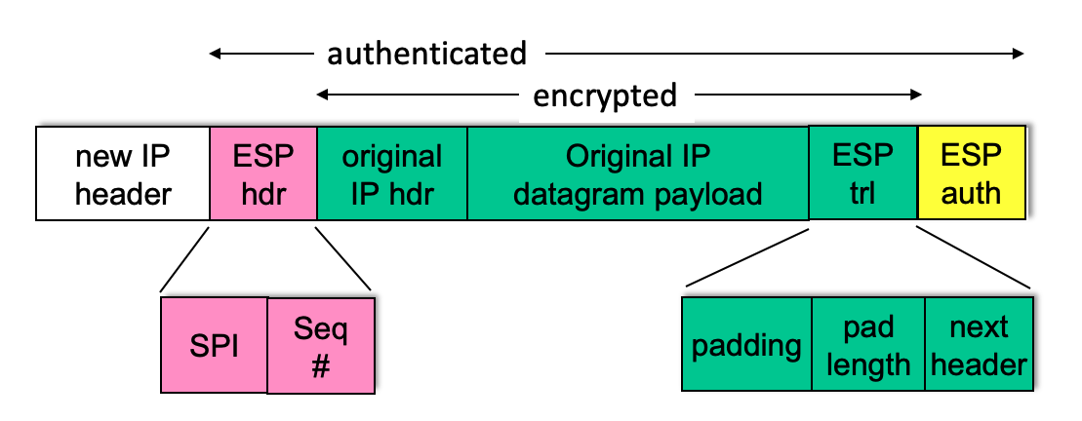
ESP tunnel mode: actions
payload
at R1:
appends ESP trailer to original datagram (which includes original header fields!)
encrypts result using algorithm & key specified by SA
appends ESP header to front of this encrypted quantity
creates authentication MAC using algorithm and key specified in SA
appends MAC forming payload
creates new IP header, new IP header fields, addresses to tunnel endpoint
R1
payload

Slide 91
Summary: IPsec services
Trudy sits somewhere between R1, R2. she doesn’t know the keys
will Trudy be able to see original contents of datagram? How about source, dest IP address, transport protocol, application port?
flip bits without detection?
masquerade as R1 using R1’s IP address?
replay a datagram?

Slide 92
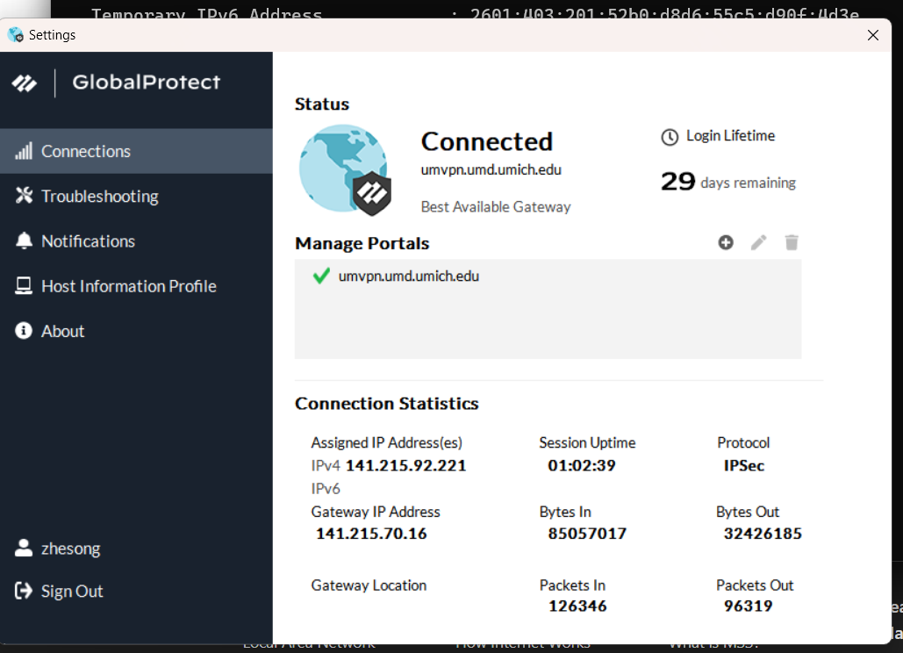
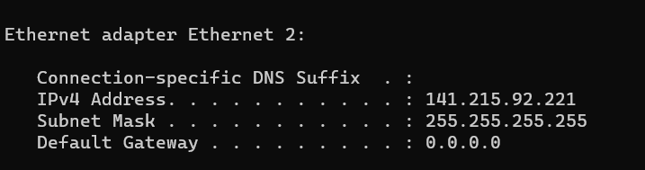
VPN
Tunnel mode IPSec
Two endpoints: your computer and VPN router (gateway)

Slide 93
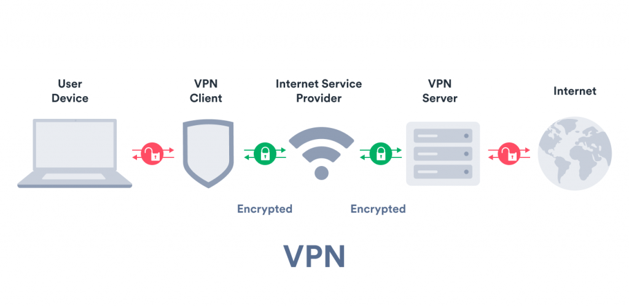
How VPN Works
Notes:
VPN CLIENT = GATEWAY (ROUTER OR SERVER OR LOCAL SOFTWARE)
VPN client example: VPN globalConnect.
VPN Server also running same software as VPN client.

Slide 94
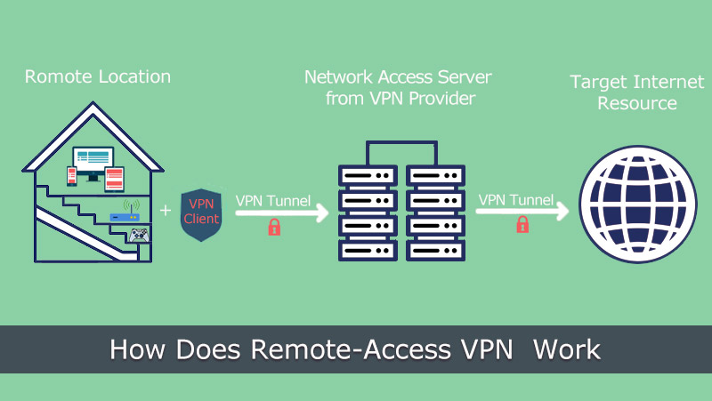
Is this right?

Slide 95
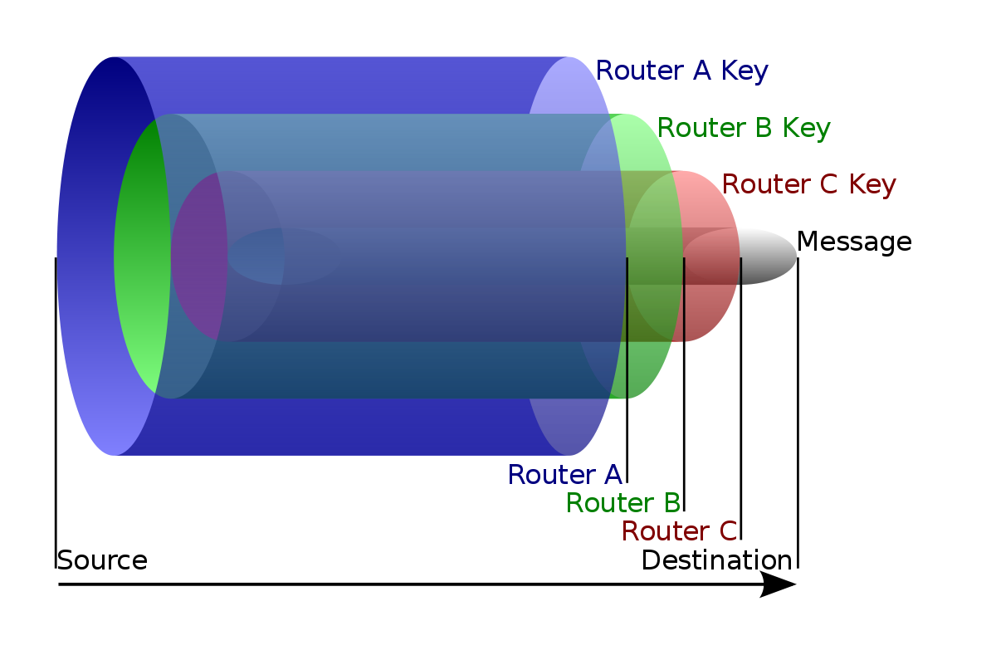
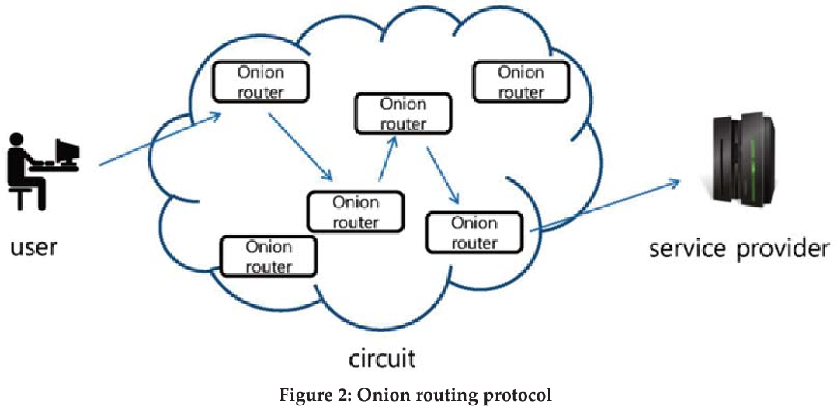
Onion Routing
Prevent from tracking back.
encrypted data is transmitted through a series of network nodes called onion routers, each of which "peels" away a single layer, uncovering the data's next destination.
Notes:
Onion Routers are not real routers but rather other users → non intermediary devices.
Used in TOR.

Slide 96
Chapter 8 outline
What is network security?
Principles of cryptography
Authentication, message integrity
Securing e-mail
Securing TCP connections: TLS
Network layer security: IPsec
Security in wireless and mobile networks
802.11 (WiFi)
4G/5G
Operational security: firewalls and IDS

Slide 97








802.11: authentication, encryption
mobile
AS
Authentication Server
AP
wired network
Arriving mobile must:
associate with access point: (establish) communication over wireless link
authenticate to network
Notes:
WIFI requires Link Layer security (since WIFI is link layer).
Especially wireless is broadcast through the air to everyone nearby.

Slide 98
802.11: authentication, encryption
mobile
AS
Authentication Server
AP
wired network
discovery of security capabilities
1
1
discovery of security capabilities:
AP advertises its presence, forms of authentication and encryption provided
device requests specific forms authentication, encryption desired
although device, AP already exchanging messages, device not yet authenticated, does not have encryption keys

Slide 99
802.11: authentication, encryption
mobile
AS
Authentication Server
AP
wired network
discovery of security capabilities
1
mutual authentication, key derivation
2
2
mutual authentication and shared symmetric key derivation:
AS, mobile already have shared common secret (e.g., password)
AS, mobile use shared secret, nonces (prevent relay attacks), cryptographic hashing (ensure message integrity) to authenticating each other
AS, mobile derive symmetric session key

Slide 100
802.11: WPA3 handshake
mobile
AS Authentication Server
Initial shared secret
Initial shared secret
Nonce_{AS}
derive session key K_{M-AP} using initial-shared-secret, Nonce_{AS}, Nonce_{M}
a
b
c
derive session key K_{M-AP} using initial shared secret , Nonce_{AS}, Nonce_{M}
Nonce_{M}, HMAC(f(K_{AS-M},Nonce_{AS)})
AS generates Nonce_{AS}, sends to mobile
mobile receives Nonce_{AS}
generates Nonce_{M}
generates symmetric shared session key K_{M-AP} using Nonce_{AS}, Nonce_{M}, and initial shared secret
sends Nonce_{M}, and HMAC-signed value using Nonce_{AS} and initial shared secret
AS derives symmetric shared session key K_{M-AP}
a
b
c
Notes:
WPA 1 and 2 are outdated protocol but many old routers still run it which is why it can be unsafe to connect to public wifi networks.

Slide 101
802.11: authentication, encryption
mobile
AS
Authentication Server
AP
wired network
discovery of security capabilities
1
mutual authentication, key derivation
2
Shared symmetric key distribution
3
3
shared symmetric session key distribution (e.g., for AES encryption)
same key derived at mobile, AS
AS informs AP of the shared symmetric session

Slide 102
802.11: authentication, encryption
mobile
AS
Authentication Server
AP
wired network
discovery of security capabilities
1
mutual authentication, key derivation
2
shared symmetric key distribution
3
encrypted communication over WiFi
4
4
encrypted communication between mobile and remote host via AP
same key derived at mobile, AS
AS informs AP of the shared symmetric session

Slide 103
Chapter 8 outline
What is network security?
Principles of cryptography
Authentication, message integrity
Securing e-mail
Securing TCP connections: TLS
Network layer security: IPsec
Security in wireless and mobile networks
Operational security: firewalls and IDS

Slide 104

Firewalls
firewall
isolates organization’s internal network from larger Internet, allowing some packets to pass, blocking others
administered
network
public
Internet
trusted “good guys”
untrusted “bad guys”
firewall

Slide 105
Firewalls: why
prevent denial of service attacks:
SYN flooding: attacker establishes many bogus TCP connections, no resources left for “real” connections
prevent illegal modification/access of internal data
e.g., attacker replaces CIA’s homepage with something else
allow only authorized access to inside network
set of authenticated users/hosts
three types of firewalls:
stateless packet filters
stateful packet filters
application gateways

Slide 106
Stateless packet filtering
Should arriving packet be allowed in? Departing packet let out?
internal network connected to Internet via router firewall
filters packet-by-packet, decision to forward/drop packet based on:
source IP address, destination IP address
TCP/UDP source, destination port numbers
ICMP message type
TCP SYN, ACK bits

Slide 107
Stateless (no history recorded or considered) packet filtering: example
Should arriving packet be allowed in? Departing packet let out?
example 1: block incoming and outgoing datagrams with IP protocol field = 17 and with either source or dest port = 23
result: all incoming, outgoing UDP flows and telnet connections are blocked
example 2: block inbound TCP segments with ACK=0
result: prevents external clients from making TCP connections with internal clients, but allows internal clients to connect to outside

Slide 108
Stateless packet filtering: more examples
Policy | Firewall Setting
no outside Web access | drop all outgoing packets to any IP address, port 80
no incoming TCP connections, except those for institution’s public Web server only. | drop all incoming TCP SYN packets to any IP except 130.207.244.203, port 80
prevent Web-radios from eating up the available bandwidth. | drop all incoming UDP packets - except DNS and router broadcasts.
prevent your network from being used for a smurf DoS attack. | drop all ICMP packets going to a “broadcast” address (e.g. 130.207.255.255)
prevent your network from being tracerouted | drop all outgoing ICMP TTL expired traffic

Slide 109
Access Control Lists
ACL: table of rules, applied top to bottom to incoming packets: (action, condition) pairs: looks like OpenFlow forwarding (Ch. 4)!
action | source address | dest address | protocol | source port | dest port | flag bit
allow | 222.22/16 | outside of 222.22/16 | TCP | > 1023 | 80 | any
allow | outside of 222.22/16 | 222.22/16 | TCP | 80 | > 1023 | ACK
allow | 222.22/16 | outside of 222.22/16 | UDP | > 1023 | 53 | ---
allow | outside of 222.22/16 | 222.22/16 | UDP | 53 | > 1023 | ----
deny | all | all | all | all | all | all

Slide 110
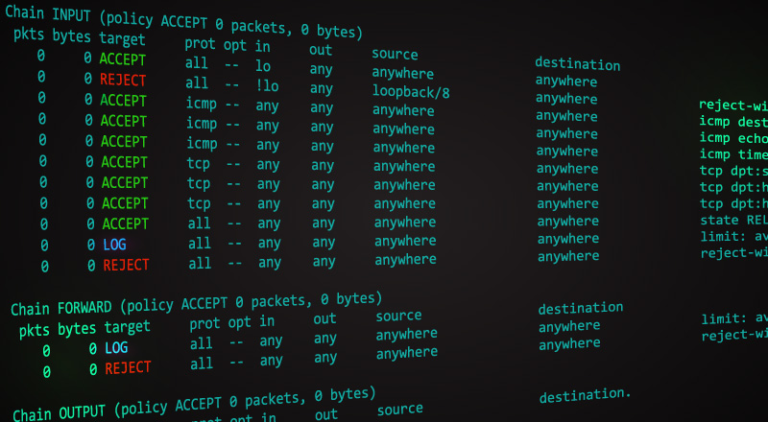
Iptable on Ubuntu
iptables -A INPUT -p tcp --dport ssh -s 10.10.10.10 -j DROP
block SSH connections from 10.10.10.10.

Slide 111
Stateful packet filtering
stateless packet filter: heavy handed tool
admits packets that “make no sense,” e.g., dest port = 80, ACK bit set, even though no TCP connection established:
action | source address | dest address | protocol | source port | dest port | flag bit
allow | outside of 222.22/16 | 222.22/16 | TCP | 80 | > 1023 | ACK
stateful packet filter: track status of every TCP connection
track connection setup (SYN), teardown (FIN): determine whether incoming, outgoing packets “makes sense”
timeout inactive connections at firewall: no longer admit packets

Slide 112
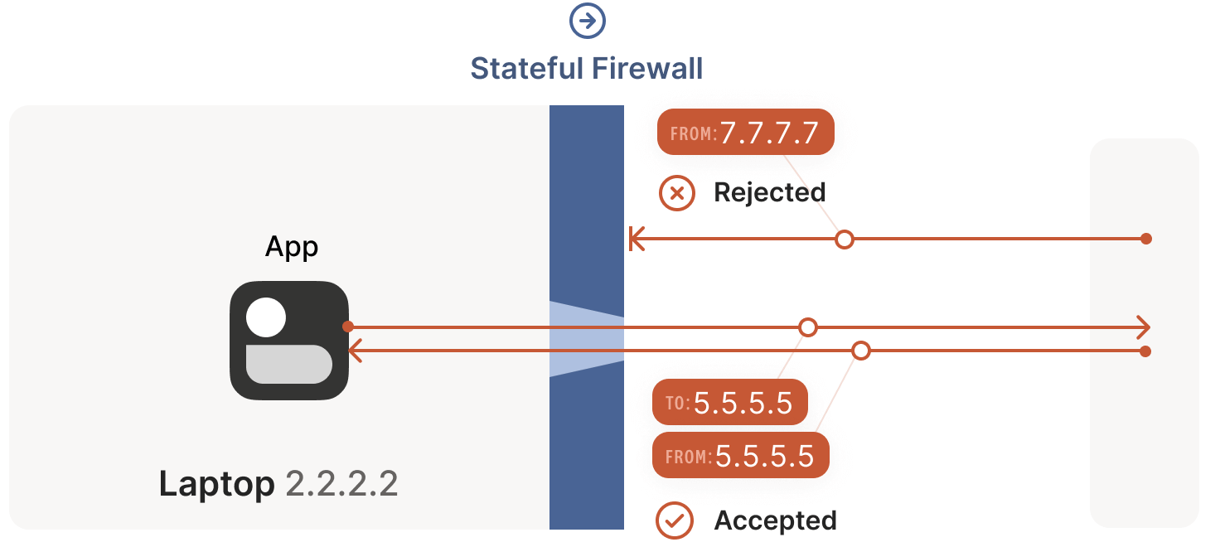
Stateful packet filtering Example

Slide 113
Intrusion detection systems
packet filtering:
operates on TCP/IP headers only
no correlation check among sessions
IDS: intrusion detection system
deep packet inspection: look at packet contents (e.g., check character strings in packet against database of known virus, attack strings)
examine correlation among multiple packets
port scanning
network mapping
DoS attack

Slide 114
Intrusion detection systems
multiple IDSs: different types of checking at different locations
firewall
internal
network
Internet
IDS
sensors
Web
server
demilitarized
zone
DNS
server
FTP
server

Slide 115
Network Security (summary)
basic techniques…...
cryptography (symmetric and public key)
message integrity
end-point authentication
…. used in many different security scenarios
secure email
secure transport (TLS)
IP sec
802.11, 4G/5G
operational security: firewalls and IDS

